Slide 1




DIGITAL LITERACY
SKILLS
INTERMEDIATE USERS

Slide 2
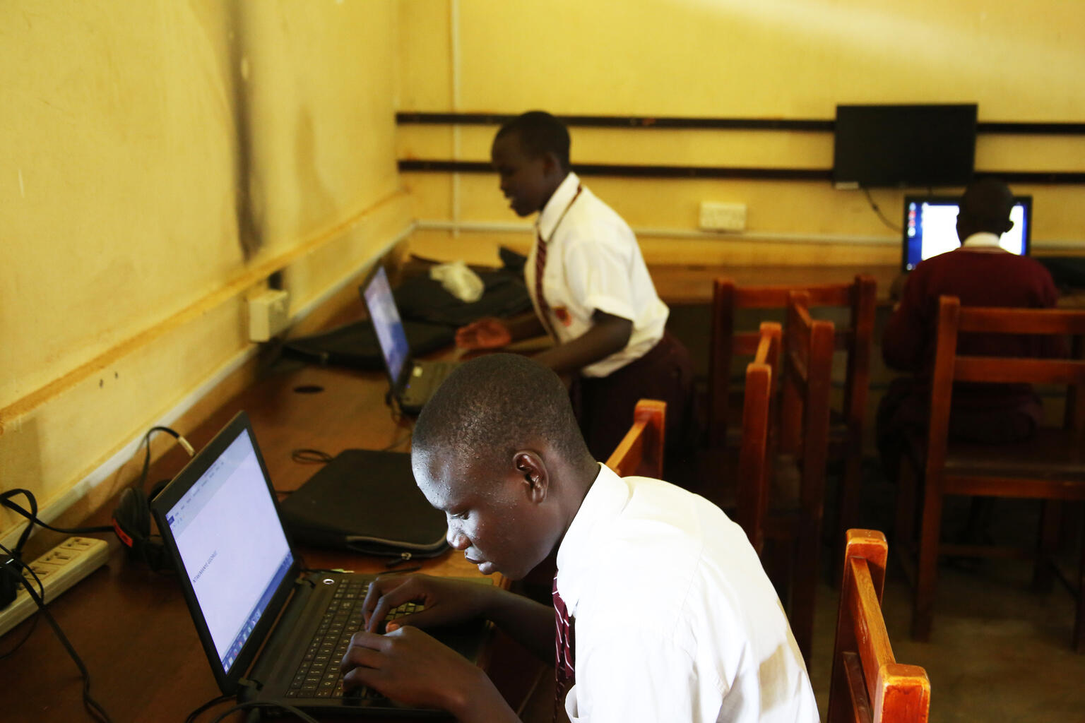
Module 6
Problem solving

Slide 3

3
Unit 3: Creatively using digital technologies

Slide 4

Digital creativity
Creativity is one of the most highly valued traits of the 21st century.
Digital creativity is a rapidly growing field.
Digital creativity is more than the sum of digital + creativity.

Slide 5
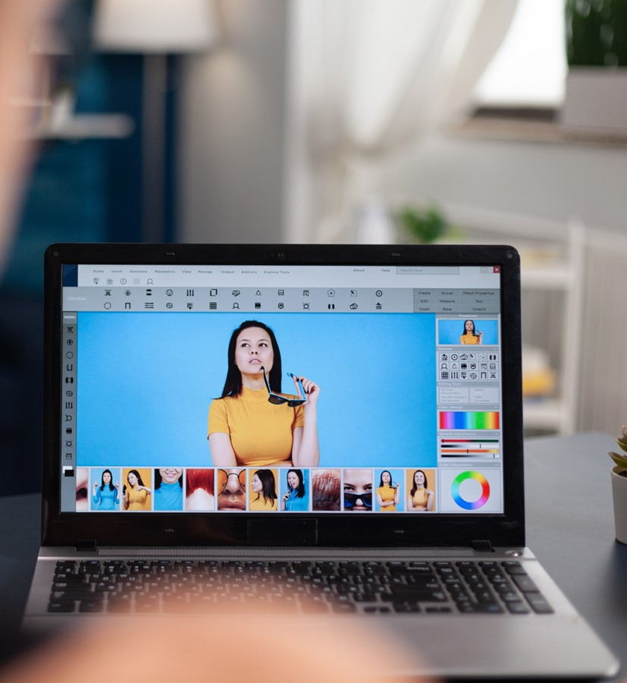
Digital creativity tools
Text editing
Photo editing app
Calendars
Social media apps
Media editing
Designing presentations

Slide 6
Skills to practise
Explore settings
When you use a software or app often, you encounter problems that you are unable to solve.
Create a list of these issues as they arise
Use the internet and find vlogs or websites that offer step-by-step solutions to your problem.
Remember that you cannot change default settings if you do not own the device that you are using.

Slide 7
All back covers should include
contact information of the section
producing the work.
© United Nations Children’s Fund (UNICEF) [month and year of publication]

